Slide 1

DISCIPLINe TRAINING
To familaize amvets on the process and procedures for filing a grievance

Slide 2
AMVETS DISCIPLINE PHILOSOPHY
The Amvets discipline procedures are designed to balance the members individual rights with the need for good order within our organization, while also allowing for the correction of inappropriate behavior
Members do not forfeit their constitutional rights when they join or when they violate our standards.
They maintain the right to face their accuser and they have the right against self incrimination.
Members cannot be disciplined without due process and punishment can only be administered following a finding of guilt at a hearing.
A primary discipline objective is that each Post will be the judge of its own membership

Slide 3

Employee Discipline
Discipline of employees is covered by State and Federal Statutes which are included in the Department of Florida Personnel Policy.
All matters involving employees will be handled in accordance with the Personnel Policy

Slide 4
Types of Grievances
Category A – for serious offenses
Category B – For violations against House Rules

Slide 5
CATEGORY A
Filed within 45 days of Discovery
Against an AMVET – heard by Post Executive Committee
Against subordinate organization or member of another post – Department Commander will forward to appropriate Post Commander or Department Subordinate Organization
Against Post Commander – Forwarded to Department Commander
If found guilty – member may be suspended or expelled from AMVETS

Slide 6
CATEGORY B
Filed within 15 days of incident
Applys to ALL members with canteen privileges
No matter which subordinate organization or Post the member belongs to
If accused is Ladies Aux or Son, the charges are processed by Post Commander
If accused is AMVET from another Post, charges are handled through the Department Commander to the Post Commander the member belongs to
Maximum punishment is permanent denial of canteen privleges

Slide 7
GRIEVANCE PROCEDURES
Begins when one member charges another
Charges must be notarized and filed with the Commander.
Hearing authority determines if charges are valid
If not valid, member is notified that charges will not be filed
If found to be frivolous, accuser can be charged with a category A charge
If accuser is from another post, charges will go through the Department Commander to the Commander of the post the member belongs to

Slide 8
GREIVANCE PROCEDURES CONT’
Commander determines if suspension pending the hearing is warranted
Letter must contain:
The specific charge
Specifications relating to the specific charge
The category of the charge
The date, time and place of hearing
Notice of hearing and formal charges sent to accused via certified letter return receipt requested within 5 days of receipt of charges

Slide 9
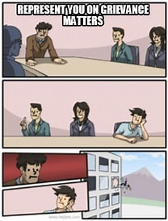
GRIEVANCE COMMITTEE
The Post Executive Committee or the Department Executive Board, consisting of a minimum of five (5) members, shall hear the charges
If Category A – members must be from the Post Executive Committee
If Category B – members should not be from the Executive Committee
If there is an objection to a question, the Presiding Officer of the committee shall decide as to the relevancy of evidence and the regularity of the proceedings.

Slide 10
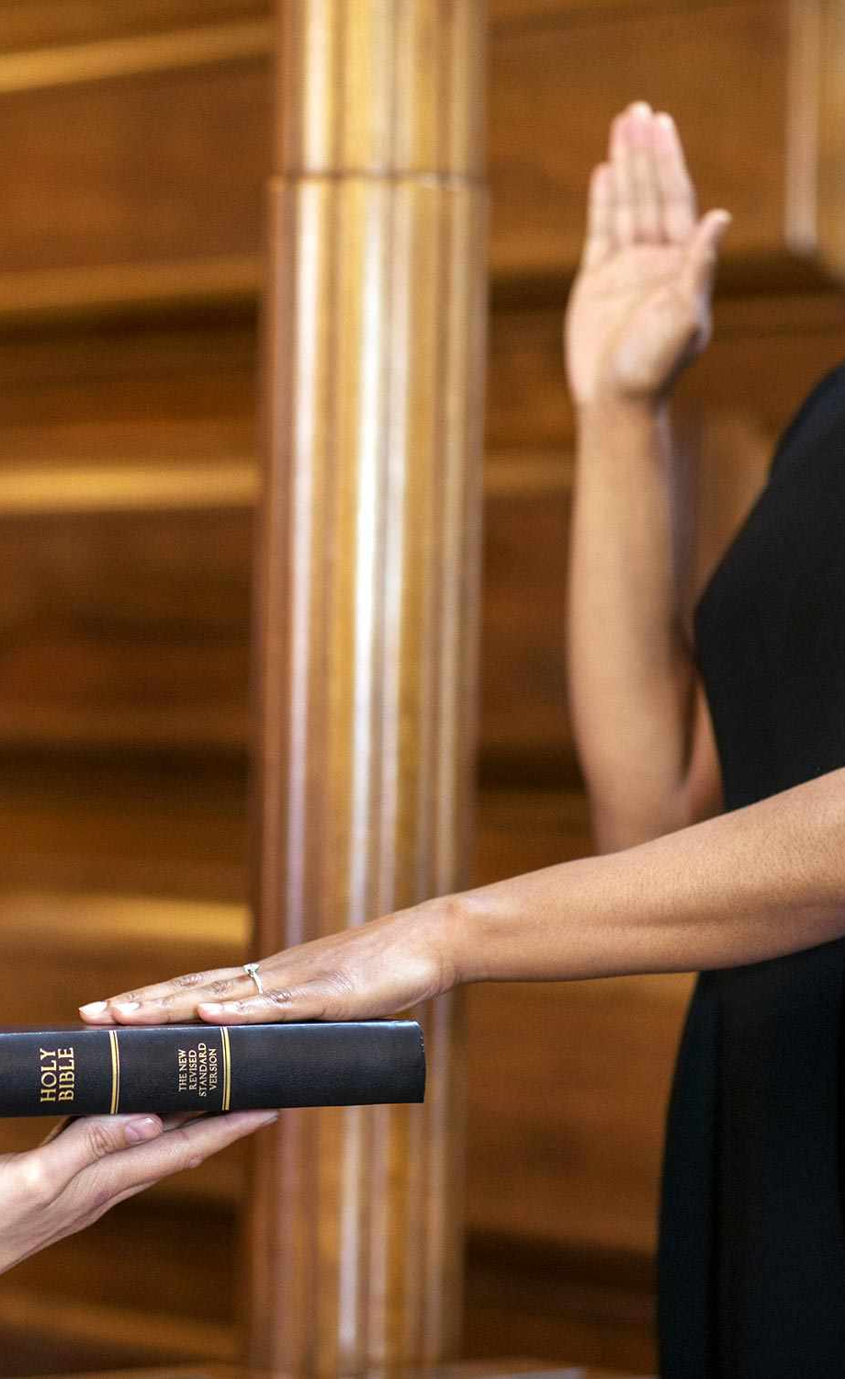
HEARING
Post JA acts as prosecutor
Representative speaks for accused
Witnesses only allowed in hearing while being questioned
Committee left alone during deliberations
Deliberations are secret and will not be recorded
Committee determines quilt or innocence
Two-thirds vote required to determine guilt
If found guity the Committee determines the punishment

Slide 11
HEARING CONT’
JA and accused notified of findings
Accused officially notified in writing of the results and their right to appeal
Committee makes results available to membership and recommends punishment

Slide 12
APPEALS
Reserve to ensure members rights have not been abused
Based on a procedural errors in the proceedings that affects the rights of the member
Not designed to rehear the case
Member must specify the procedural errors that may have led to the violation of their rights

Slide 13
APPEALS CONT’
Referred to a level above the original hearing
Must be filed within 15 days
Category A offense appeals - filed with the Department Executive Director
Department Commander and Department JA provides recommendation to Grievance Committee
Committee decision is final

Slide 14
APPEALS CONT’
Category B offense appeals - filed with the Post Commander, to be handled by the Post Executive Board
Post Commander refers appeal to Post Executive Committee
Committee decision is final

Slide 15
APPEALS CONT’
Committee votes to determine
the charges and punishment on appeal shall be upheld
The charges are upheld and the punishment reduced
Charges and punishment are not upheld
A 2/3 vote of the committee is required to sustain the charges and punishment on appeal
Committee cannot increase the punishment

Slide 16
SUSPENSION OF MEMBERSHIP AND MEMBERSHIP PRIVILEDGES
Tools Commanders use to help maintain good order in the Post
These are not punishment
Intended to protect the accused and the membership
Punishment can only occur after a finding of guiley at a hearing
Suspensions can only be imposed after the Commander receives notarized charges and determines they are valid
Commanders should use discretion when imposing suspensions prior to hearing
Can only last from time of notification to the hearing

Slide 17
SUSPENSION OF MEMBERSHIP AND MEMBERSHIP PRIVILEGES CONT’
Category A offense
Suspension pending hearing
Not allowed on post property except hearing
Violation is considered trespassing

Slide 18
SUSPENSION OF MEMBERSHIP AND MEMBERSHIP PRIVILEGES CONT’
Category B offense
Suspension of canteen priviledges
Can participate in Post functions
Cannot be signed in as a guest

Slide 19
SUSPENSION OF MEMBERSHIP AND MEMBERSHIP PRIVILEGES CONT’
Servers can deny service to intoxicated members and ask them to leave
Max time is 24 hours
Alternate transportation should be arranged

Slide 20

SPECIAL CIRCUMSTANCES
Certain circumstances may require a modification to the normal procedures to ensure a fair conclusion to discipline matters

Slide 21

CHARGES OF A CRIMINAL NATURE
Commanders work with law enforcement
Procedures should run in concert with criminal proceedings
Delay hearings until the conclusion of any legal actions
Use court findings during grievance

Slide 22
COMMANDER AS ACCUSER
Gives notarized charges to 1st Vice
Removes himself/herself from all decisions regarding the case
1st Vice assumes responsibilities of Commander for this case
Handles case without influence, input or consultation from the Commander

Slide 23
JUDGE ADVOCATE NOT AVAILABLE
Commander appoints AMVET to assume the responsibilities for this case only
Member must be a member of the Post
Cannot appoint a member of another Post to act as JA

Slide 24

EXECUTIVE COMMITTEE NOT AVAILABLE
Commander appoints other AMVET members

Slide 25
CHARGES AGAINST POST COMMANDERS
Handled at Department Level
Notarized charges are sent to the Department Commander

Slide 26
CHARGES AGAINST SUBORDINATE MEMBER
Commander forwards charges to Department Commander
Department Commander forwards to appropriate Subordinate Organization

Slide 27
CHARGES FILED BY SUBORDINATE MEMBER
Category A charges cannot be filed against an AMVET by a subordinate organization member
Subordinate organization members can file charges for violation of House Rules

Slide 28
RECORD KEEPING
Keep written records
Communicate in writing with the accused and accuser
Investigation results in writing
Include a timeline with dates and times of all conversations and actions
Maintain records securely for a minimum for two years following the end of all appeals

Slide 29
TIMELINESS OF ACTIONS
Commander has 5 days to take action on all charges
Determine validity of charges and take action within those 5 days
Minimum of 30 days required before a hearing can take place
Settle matters in a timely manner
To delay discipline is not conducive to good order and discipline
Commanders are accountable for excess delays
Delaying due to pending criminal proceedings is allowed

Slide 30
STATUTE OF LIMITATIONS
Category A – 45days of discovery
Category B – 15 days of occurrence

Slide 31
MEMBER IN GOOD STANDING
Members who are fully paid up in all accounts with no charges pending against them
Only members in good standing can charge other members

Slide 32

RETALIATION
NOT TOLERATED

Slide 33
SUBORDINATE ORGANIZATIONS
Actions will be observed by the Post of AMVETS to which the organization belongs to
Suspended members cannot be signed in as quest

Slide 34

Conclusion
AMVETS Discipline Philosophy
Types of Grievances
Grievance Procedures
Suspension of Membership and Membership Privileges
Special Circumstances

Slide 35


Slide 36
SHARON DAVIS
DEPARTMENT OF FLORIDA JUDGE ADVOCATE
Amvetsfl.ja2021@gmail.com
813-748-4650

